Slide 1


HR ANALYTICS
Employee Retention
EMPLOYEE RETENTION

Slide 2


Project Name : Employee Retention Domain : HR Analytics

Slide 3
Presentation Outline
Introduction
Objectives
Methodology
KPI’s
Dashboard
Strategies for Improving Employee Retention
Recommedation
Conclusion

Slide 4
Introduction: HR analytics involves the collection and analysis of HR-related data, including employee data, performance metrics, and other relevant data points. By using advanced analytical tools and techniques, HR analytics provides valuable insights into HR processes and trends, enabling organizations to make more informed decisions about their employees and improve overall performance.
KPI’s:
Average attrition rate for all Departments
Average hourly rate of Male Research Scientist
Attrition rate Vs Monthly Income stats
Average working years for each Department
Job role Vs Work life balance
Attrition rate Vs Years Since last promotion

Slide 5
Objective:
The aim of this project is to analyze employee retention and attrition rates with the organization and provide insights to the HR team for developing effective retention strategies. Through data analysis and visualizations, we will identify factors that contribute to :
Employee attrition.
Evaluate the effectiveness of existing retention strategies.
To verify the satisfaction level of employee in the organization.
Provide recommendations to improve employee retention.

Slide 6
Methodology
Data Cleaning Process
Before modeling, we implement a thorough data cleaning process to ensure the accuracy and reliability of the dataset. This involves handling missing values, removing duplicates, and addressing any inconsistencies in the data.
Feature Engineering
During the data modeling phase, we focus on feature engineering to extract relevant insights from the dataset. This involves creating new features, transforming existing ones, and selecting the most influential variables for the model.
Model Selection and Validation
We employ a rigorous approach to model selection and validation, utilizing techniques such as cross-validation and ensemble methods to ensure the robustness and generalizability of the model's performance.

Slide 7
KPI 1 Average Attrition rate for all Departments
This KPI is to find out the
relationship between each
department and its attrition rate and here attrition rate is highest for Research & Development Department whereas lowest is for Hardware Department.

Slide 8
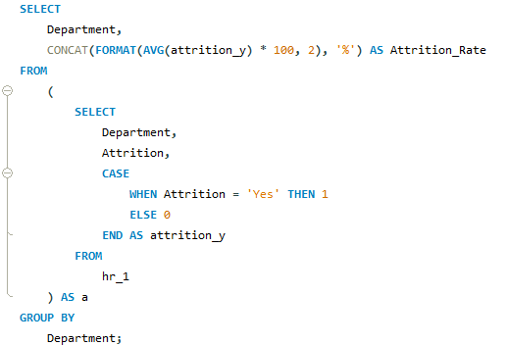
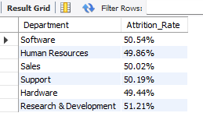
Insights from KPI 1:
We can clearly say that attrition rate of employees for every department is almost 8% which indicates that attrition rate of employees does not depends on department.
From this calculation and visualization we concluded that we must make strong strategies to minimize attrition rate and improve our company’s Employee retention so that we can balance the company’s growth and right talent.

Slide 9
KPI 2 Average Hourly rate of Male Research Scientist
Average Hourly rate of Male Research Scientist
Avg. Hourly Rate Research Scientist
114.45
Insights from KPI 2 :
This KPI is to find out the average hourly rate of male research scientists along all the departments which is 114.45

Slide 10
KPI 3 Attrition Rate Vs Monthly Income Stats
This KPI is to find out the relation the between monthly income and Attrition rate.

Slide 11
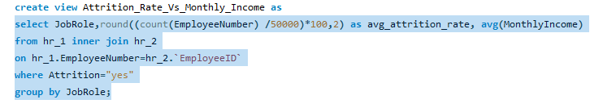
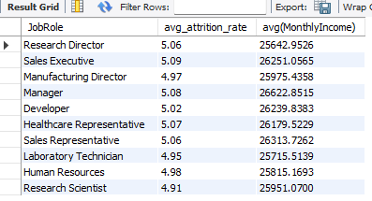
Insights from KPI 3:
Based on our analysis and visualization, it is evident that the Research Scientist has the lowest attrition rate of 4.91%, with an average monthly income of Rs.25,951.07. On the other hand, the Sales Executive has the highest attrition rate of 5.09%, with an average monthly income of Rs. 26,251.05.

Slide 12
KPI 4 Average Working Years for each Department

Slide 13
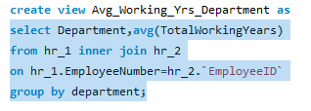
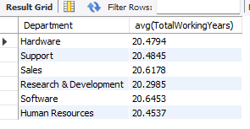
Insights from KPI 4:
From this we can see the average working years in software department is high as compared to the rest of the departments and lowest is for Research & Development Department.
From the analysis we can conclude that average working years is approximately 20 for all the departments.

Slide 14
KPI 5 Job Role Vs Work Life Balance for Total Employees

Slide 15
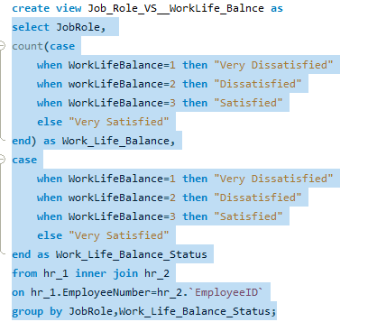
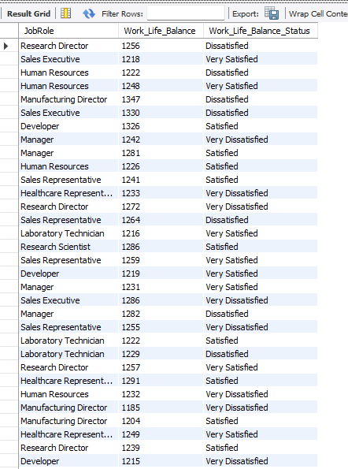
Insights from KPI 5:
From the analysis we can conclude the work life balance for the attrition employees as below,
Research Directors are Very Dissatisfied with Work – Life balance.
The work life balance of Sales representatives , Manufacturing Directors , Managers and Sales executives seems to be Dissatisfying.
Human resources , laboratory technicians, Research Scientists , Healthcare representatives and Developers are more likely to be Satisfied.

Slide 16
KPI 6 Attrition Rate Vs Years Since Last Promotion

Slide 17
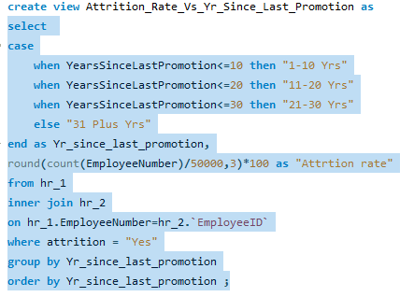
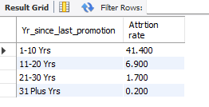
Insights from KPI 6:
Whereas, the year since last promotion is above 31 years has the lowest attrition rate.
The highest attrition rate is seen where the year since last promotion is between 1-10 years

Slide 18

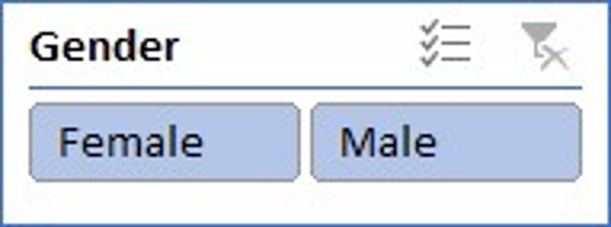
Dashboard
HR ATTRITION DASHBOARD
Avg Hourly Rate Reaserch
Scientist
115
Total Employees
Attrition Count
Average Age
Current Employees
Attrition Rate
50000
25105
39
24895
50.21%
Job Role Vs Work Life Balance
Attrition By Age Group And Gender
Average working years for each Department
Attrition Rate Vs Monthly Income
Attrition Rate Vs Last Year Promotion

Slide 19
Strategies for Improving Employee Retention
1) Flexible Work Schedule
Allowing employees to have flexible work hours and remote work options increases job satisfaction and work-life balance.
2) Professional Development Opportunities
Providing opportunities for learning and growth through training, mentorship, and skill development programs.
3) Recognition and Rewards
Implementing a system to recognize and reward employees for their hard work and achievements.
4) Open Communication Channels
Creating an environment where employees feel heard and valued through transparent communication channels.
Improving employee retention involves implementing strategic measures to ensure that employees feel supported, valued, and motivated to stay with the company. Offering a flexible work schedule, providing opportunities for professional development, recognizing and rewarding employees, and maintaining open communication channels are key strategies that can significantly impact employee satisfaction and retention rates.

Slide 20
Conclusion :
Conduct stay interviews: Instead of exit interviews, conduct stay interviews with employees to gather feedback about the job.
Improve employee engagement: Implement initiatives to improve employee engagement, such as regular feedback, recognition and rewards programs, and opportunities for career growth.
Address workload issues: Ensure employees have manageable workloads by regularly monitoring and adjusting workloads to prevent burnout and overwhelm.
Create a positive work environment: Foster a positive work environment by promoting a culture of respect, inclusivity, and teamwork. Encourage open communication and collaboration among employees.
Address pay and compensation issues: Ensure that employees receive fair pay and compensation for their work and to find out what motivates an employee to continue to work in an organization.

Slide 21
Thank you

